Slide 1

Exploratory Data Analysis-1
Today’s Agenda
What is EDA?
Data Profiling: Overview of rows, columns, types
Data quality checks (duplicates, nulls, datatypes)
Detecting Outliers (concept only)
Data Cleaning intro (brief)
Hands-On Practice
Kahoot(Quiz)

Slide 2
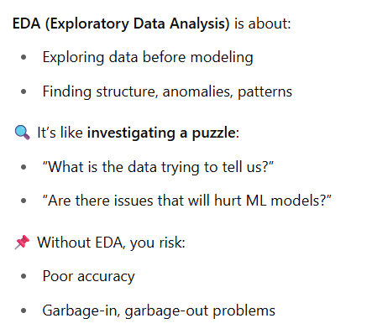
EDA Refresher – What and Why?

Slide 3
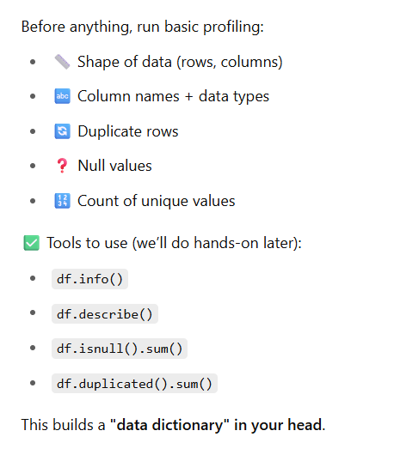
Data Profiling – Getting to Know the Dataset

Slide 4
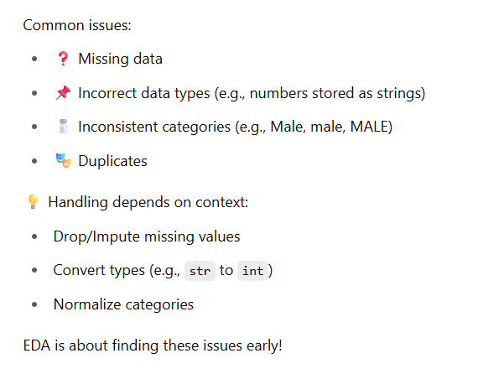
Data Quality Checks

Slide 5
Short break

Slide 6
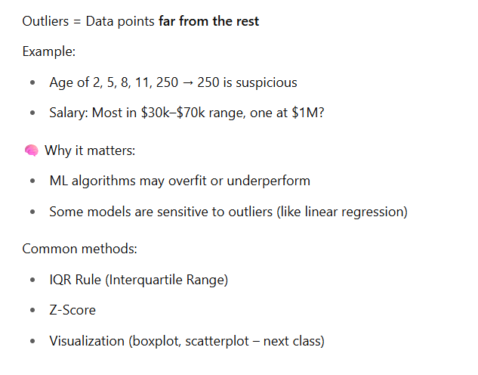
Detecting Outliers – Conceptual View

Slide 7
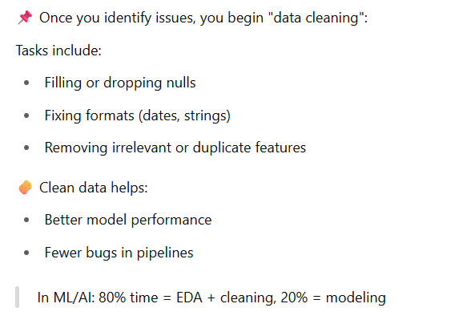
Quick Glimpse into Cleaning

Slide 8
Main Break

